Slide 1
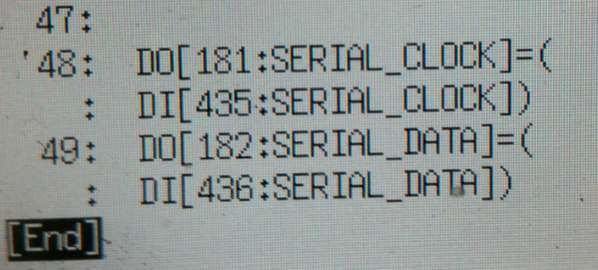
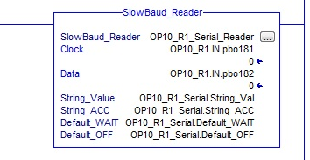
SLOWBAUD- PROGRAMMER CONSIDERATIONS.
Even the slow pace of the SlowBAUD can only compensate for a finite amount of data transfer jitter. The following recommendations will result in error-free data collection.
1) Copy the SlowBAUD inputs to the Robot-to-PLC Outputs in a Robot Background Process.
2) Monitor the inputs in the PLC using the provided AOI in in a Periodic Routine at <10mSec
The SERIAL_CLOCK pulse of the SlowBAUD is a 30Hz square wave. Using it as a “Tool Present” bit locally on the robot will require latch bits or using a WAIT FOR with TIMEOUT when checking for tool presence.
SLOWBAUD-M12(R)
Opus Technica Ltd sales@slowbaud.com (567) 712-8919

