Slide 1
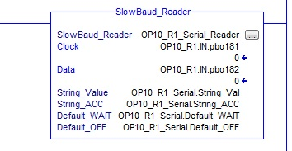
SLOWBAUD-M12 DATASHEET
DIMENSIONAL INFO
Map the 2 inputs from the SLOWBAUD to the RS-LOGIX 5000 Add-On-Instruction provided.
*RS-LOGIX 5000 vers. 16 or higher.
*Other PLCs available.
ELECTRICAL INFO | Min | Typ | Max
Supply Voltage DC | 17 | 24 | 29 | VDC
Supply Current | 10 | 20 | 75 | mA
Temperature | -40 | -- | 85 | C
Seal Rating | NEMA P6/IP67
DATA INFO
Serial Data Length | Up to 80 Characters
Data Format | ASCII, 8 bits
Programming | Factory or Field
Data Rate | 5 Baud
SLOWBAUD-M12(R)
Opus Technica Ltd sales@slowbaud.com (567) 712-8919

