Slide 1
CONCEPT–
The EOATs all have a “Jumper Plug” installed , which is used when the Robot is clamping up / unclamping an EOAT to determine presence. It Plugs into a standard M12 input socket on the robot EOAT’s Lumberg Block. It shorts one (or both) of the inputs on that socket to +24VDC. The robot programs sense the state of those inputs to determine if an EOAT is successfully clamped up or unclamped.
The SlowBAUD replaces that “Jumper Plug” with an active device which uses both of the available inputs (one CLOCK, one DATA) to drive an ASCII string at an extremely slow rate. This slow rate allows the ASCII string to be readable by the remote PLC, despite the jitter and variability of the timing induced by the process by which it is delivered to the PLC.
PREP WORK –
Robot:
1) Determine what robot inputs the “Jumper Plug” is plugged into (and subsequently the SlowBAUD will be plugged into) (Those are RI[1] and RI[2] in this example).
2) Determine two spare Robot-to-PLC outputs the robot logic will echo the SlowBAUD signals to the PLC through. (DO[181] and DO[182] in this example.)
NOTE: The following describes how you may use Robot Flag Bit to retrofit an existing jumper with a Slowbaud. If you are implementing a Slowbaud on a new system it is suggested you sense the presence of the EOAT by reading the SERIAL_CLOCK bit with a TIMEOUT function. Again, where the Flag Bit is discussed it is only when replacing the “always on” of a jumper plug is needed.
3) Determine one spare Flag bit to use as the new “EOAT present” signal for the Robot Logic (That is F[181] in this example).
4) Determine three spare registers to use to control the state of the Flag bit F[181:EOAT_Present]. We will keep track of the length of time the CLOCK signal has been low – used to turn F[181]=OFF if R[1] has been OFF longer than would be expected in its normal square wave duty cycle (R[181], R[182] and R183] in this example).
5) Determine or create a BG (Background) Process in the robot to run the SlowBAUD code in. (SHL_IO.ls in this example.)
PLC:
6) Verify the PLC is RSLogix Ver. 16 or better.
7) Determine or create a periodic PLC process that will execute AT LEAST every 10 mSec. We will add a routine there to read the Serial Data, and accumulate EOAT counts, and set Latch bits to tell the PLC logic what Part Type the loaded EOAT can run.
8) GET A LIST FROM TOOLING ENGINEERING OF ALL TOOLS THAT WILL BE RUN ON THE OP. GET SlowBAUDS PROGRAMMED WITH THOSE SERIAL NUMBERS.

Slide 2
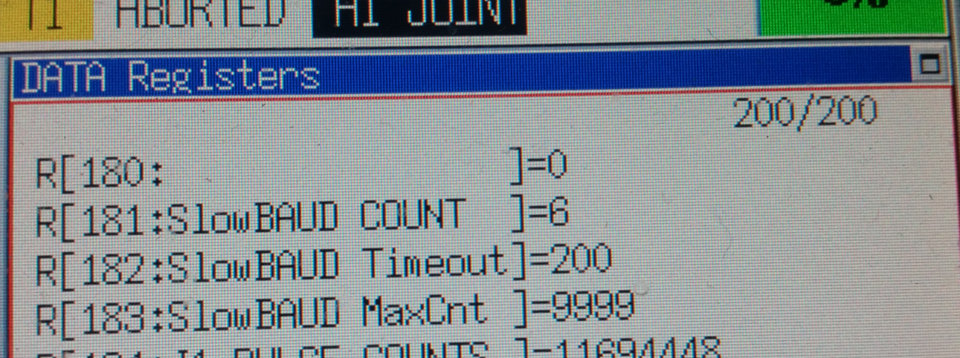
ROBOT IMPLEMENTATION –
In this example, RI[1] and RI[2] are used to sense the “Jumper Plug” indicating “EOAT Present”. Do Copy or FTP all the robot programs and use GREP to search for all instances of RI[1] or RI[2] and replace them with F[181].
Remove the “Jumper Plug” and install SlowBAUD whose Serial Label matches the EOAT on the robot. Verify the inputs - flash both on the Lumberg Block, and the RI[1] and RI[2] display in the Teach Pendant.
Name the SlowBAUD inputs “SERIAL_CLOCK” and “SERIAL_DATA”.
4) Name the selected Robot-to-PLC outputs “SERIAL_CLOCK” and “SERIAL_DATA”.
5) Name the selected Flag bit “TOOL PRESENT”.
6) Name the selected Registers “SlowBAUD Count”, “SlowBAUD Timeout” and “SlowBAUD MaxCnt”.
ROBOT IMPLEMENTATION – Continued on next page…..

Slide 3
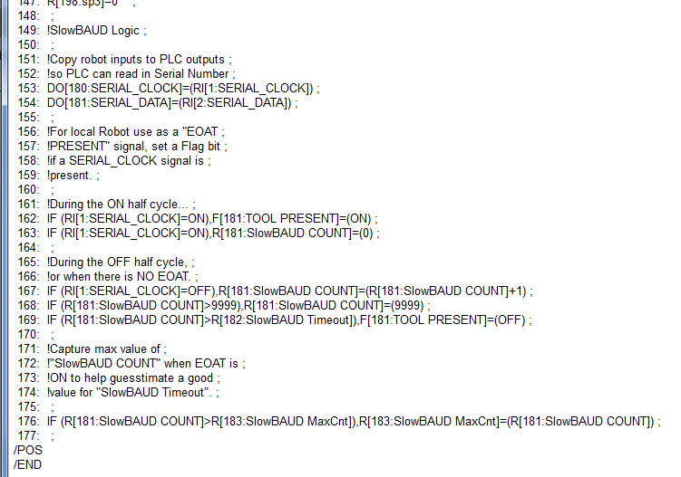
Continued from previous page….. ROBOT IMPLEMENTATION –
7) STOP the selected BG Process. Append the following code (below) at the end of the BG Process. Close the editor, and RUN the selected BG Process.
8) RUN the selected BG Process.
9) Verify DO[180] and DO[181] (outputs to PLC) have begun flashing, echoing the SlowBAUD signals.
10) Monitor the selected Registers. Enter a “0” in “SlowBAUD MaxCnt”. You should see “SlowBAUD Count” rising to some value, with the maximum value being copied into “SlowBAUD MaxCnt”.
11) Pick a value 2.5 times the Max Value and set “SlowBAUD Timeout” to that number.
12)Verify F[181] is ON. Unplug the SlowBAUD and verify F[181] goes OFF. Plug the SlowBAUD back in and verify F[181] comes back ON again.

Slide 4
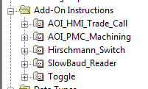
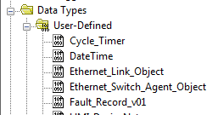
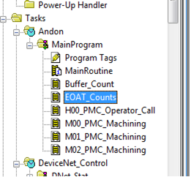
PLC IMPLEMENTATION –
Go online with the PLC controlling the Automation for the Robots in question.
If not already done, import both the “SlowBaud_Reader” AIO, and the “SlowBaud” UDT.
The SlowBAUD logic needs to reside in a Periodic Task that has an Interval of 10 milliSeconds or less. For Defiance P-Sand we will use the “Andon” Task. Add a New Routine, and name it “EOAT_Counts”.
Fix rung 0, then add “EOAT_Counts” to the end of MainRoutine.

Slide 5
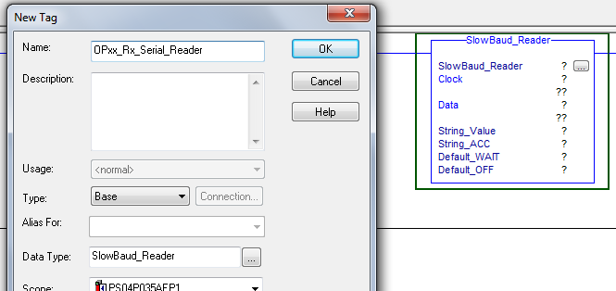
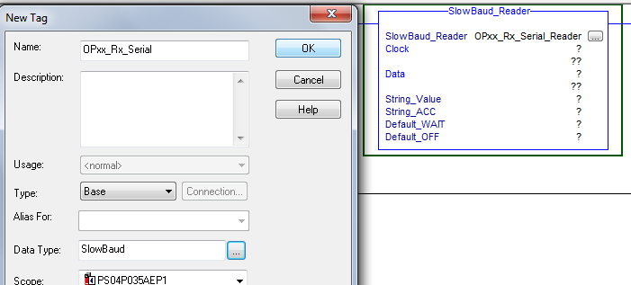
Continued from previous page….PLC IMPLEMENTATION –
5) Insert a rung, insert a SlowBaud AOI.
6) Right-click in the SlowBaud_Reader question mark, and select “New Tag”.
Use the OP# and Robot# to replace the “X”s in the example below, making a unique Control Tag for the AOI for reading this OP/Robot’s SlowBaud clock/data.
7) Next, right-click in the String_Value question mark, and select “New Tag”.
!!!CRITICAL!!! YOU MUST CHANGE THE DATA TYPE FROM “String” to “SlowBaud” before creating the new tag.
Use the same OP# and Robot# to replace the “X”s in the example below, making a unique Control Tag for the UDT for holding the SlowBaud clock/data.

Slide 6
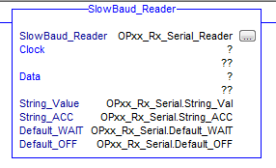
Continued from previous page….PLC IMPLEMENTATION –
Populate the four string variables with their appropriate UDT Tag elements by following the example below:
Right-click, monitor any of the “OPxx_Rx_Serial” tags to pull up the monitor page.
Do nothing to the “String_Val” or “String_ACC” elements.
Change “Default_WAIT” to the string “Reading…..”. (5 dots)
Change “Default_OFF” to the string “Disconnected”
NOTE: both strings must be 12 characters long.

Slide 7
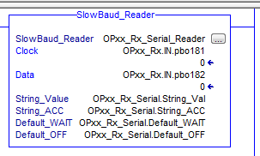
Continued from previous page….PLC IMPLEMENTATION –
For the last step of filling in the AOI, assign the Clock input to the tag that is echoing the SlowBAUD Clock, and the Data input to the tag that is echoing the SlowBAUD Data bit.
Accept the changes to the rung. If all is right, when you monitor the “String_VAL” and “String_ACC” variables, you will see the Serial Number from the SlowBAUD slowly scrolling into “ACC”, then being transferred as a whole into “VAL”.
So, you have successfully set up the Serial Transfer of the SlowBAUD Data into a String Tag in the PLC.

